Slide 1
Heidelberg Research Architecture: Status and perspectives
Workshop: LitLink: A Cue Card System in a Research Environment of Collaborative Work, Online Publishing and GIS, Heidelberg,
February 25, 2010
Peter Gietz gietz@asia-europe.uni-heidelberg.de

Slide 2
Agenda
Introduce the Cluster
Challenges for the HRA
HRA Databases and projects
How we integrate different databases and services
Some remarks on possible LitLink integration

Slide 3
The Cluster of Excellence
"Asia and Europe in a Global Context"
Part of the German Federal Excellence Initiative
"to establish internationally visible, competitive research and training facilities"
A cluster of over 60 interdisciplinary projects
Analysing cultural interactions between Asia and Europe
Includes a virtual research infrastructure called Heidelberg Research Architecture (HRA)‏

Slide 4
The Cluster of Excellence
Has 4 Research areas:
Research Area A: Governance and Administration
Research Area B: Public Spheres
Research Area C: Health and Environment
Research Area D: Historicities and Heritage
And as a 5th Area the HRA
Scholars from different fields are involved:
Sinology, Indology, History of Arts, East Asian Arts, Science of Religions, Archaeology, History, Assyrology, Medicine, Computer linguistics etc...

Slide 5
The Cluster of Excellence
Has a dedicated agenda:
Finding and analysing flows of concepts
That happen within shifting asymmetries
Globalisation is not a new phenomenon, but has happened since the beginning of man kind
Every thing is part of this global process
People are a medium of such flows
More information available at:
http://www.asia-europe.uni-heidelberg.de

Slide 6
What are the technical requirements?
Large amount of different databases already exist
Language resources
Image resources
Bibliographical resources
Music, Films, etc. etc.
Most Cluster project will have the need for such or new data bases

Slide 7
How to store concepts
How to get all these data into one system?
How can one-dimensional metadata be enhanced?
How can flows be described?
How can phenomena be linked with each other?
How can the system answer intelligent questions?

Slide 8
First answers
Different data bases can be integrated in a loosely coupled system
In a Service Oriented Architecture
One central metadata base can be a central retrieval point
One big full text index on cluster resources can be helpful
New Semantic Web technologies might be even better for storing and finding conceptual flows

Slide 9
Aims of HRA
Sustainable competitive advantages can only be achieved by efficient utilisation of IT
A common platform called Heidelberg Research Architecture (HRA) will be set up that is accessible to all participants and partner organisations
For maximum efficiency and minimal expenditure, the Cluster will, wherever possible, work with systems already available at the University

Slide 10
HRA
HRA consists of two main sections:
a database architecture that can be utilised for research projects such as the Translingual Concepts Dabatase (TCD) and the Transcultural Images Database (TID);
the IT infrastructure required for a modern work environment, providing tools for close interaction within the Cluster's Research Areas and other scholarly publics.

Slide 11
Existing Infrastructure
Relevant infrastructure already available at
the institutions participating in the Cluster
the University Computing Centre
the University Library
the University’s Interdisciplinary Centre for Scientific Computing

Slide 12
Existing Infrastructure
Relevant infrastructure already available:
file- and directory-services
storage and backup provisions
eLearning platform
a content management system
image database
electronic publishing facilities
a digitisation centre

Slide 13
Database Infrastructure
both the analytical work on the databases and their use by external scholars require advanced search and information retrieval facilities which are capable of processing metadata tags
to enable cooperative work of scholars in Asia and the West, both input and retrieval of database content must be possible via web-interfaces.

Slide 14
Physical location of the HRA Databases
The databases are hosted on servers of the Cluster located at the University Computing Centre with backup arrangements installed to prevent data loss.

Slide 15
Databases acquired for HRA
ProQuest – Dissertation and Theses
the Cluster has acquired access to ProQuest – Dissertation and Theses. With more than 2.4 million entries
the most comprehensive collection of academic dissertations and theses in the world
Restricted Access (members of the University of Heidelberg)‏

Slide 16
Databases acquired for HRA
ARTstor
a digital library
areas of art, architecture, and archaeology of Europe, Asia, and America
nearly one million images
Restricted Access (members of Heidelberg University)

Slide 17
Databases acquired for HRA
Index of Christian Art (Princeton Art Index)
bibliographic references to more than 20.000 works of art
with over 60.000 digital images especially on medieval art
emphasis on European art
Restricted Access (members of the University of Heidelberg)

Slide 18
Databases acquired for HRA
Yomiuri Shinbun – Meiji and Taishô Eras
articles of the daily newspaper in original layout, from 1874 to 1926
Center for East Asian Studies
Access requires password
Kokka
monthly periodical on art and architecture
Since 1889

Slide 19
HRA Databases
Within HRA a number of new databases have been set up
They are working independant but are loosely coupled
Via Several Services
That make use of the data
That provide a single retrieval point for all the data

Slide 20
Transcultural Image Database
The TID makes use of the "Heidelberg Image Database" (HeidICON), hosted by the University Library. Currently 15 cluster projects are using the database for storing more than 45.000 images and their metadata in the system.
More on this in a later presentation

Slide 21
Translingual Concepts Database
There are several strategies for storing concepts
In a first approach we developed a statements database, a resource where Cluster researchers can make statements about information objects (images, texts, bibliographic references, etc.) or about other statements.
There have been experiments with ontology technologies (RDF and Topic maps)

Slide 22
Ontology
A multi dimensional system for relating information objects
A classification system (like Dewie Decimal System) can be called a single dimensional metadata system
there is only one relation type: Is subclass of
A Thesaurus (like Roget's Thesaurus) uses more dimensions:
is part of semantic field, is connected with
Other thesauri have even more, like synonyms, antonyms, subclass, etc.

Slide 23
Ontology
An Ontology is all the above and much more
We have a hierarchical class model (like in DDC)‏
We have an unrestricted number of relation types (not only the few of a thesaurus)‏
So we can store classifications and thesauri in ontology stores
The best way to formalize an ontology entry is:
Subject – predicate – object
Where subject and object are classes or class instances
And predicate is a relation type
RDF triples

Slide 24
What do we want to do with ontologies
Find integrated knowledge
Produce new knowledge
Provide evidence for new hypotheses
Verify or challenge old hypotheses
Topic Maps are being evaluated to model the Cluster, its Projects, People and research topics

Slide 25
Cluster Bibliographic Database
Based on the open source software Refbase
Includes besides bibliographic references the actual texts as PDF files (visible only after Login)
It provides the possibility to share bibliographical entries and the associated texts
Has the usual features (citation and data export)
Some fields are only for the single user
so you can e.g. differentiate own keywords from keywords for all
The Cluster is creating an own version of refbase with additional features

Slide 26
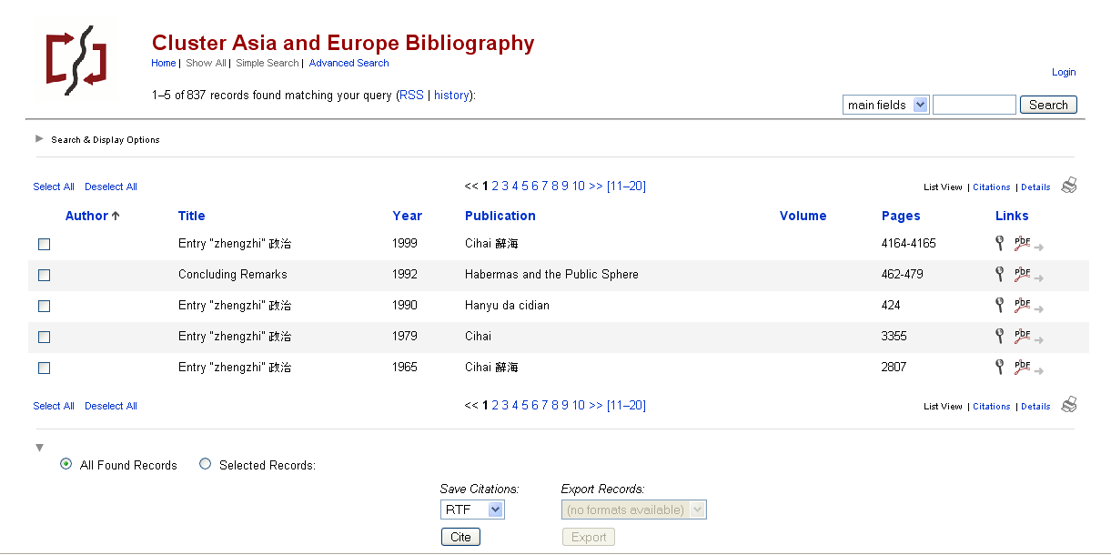
Refbase Cluster bibliography

Slide 27
New Features added by the HRA
Authentication integrated into the Active Directory based central user management (unified login strategy)
Authorization based on Active Directory Group memberships
Without Login only the bibliographical references are visible
After login PDFs are accessible and input or import of new data is possible

Slide 28
New Features added by the HRA
New input masks (quick input and extended mode)
New database fields, e.g. for inputting original script titles
Fields for Cluster publication management and integration into the website
Improved Endnote import
Etc.

Slide 29
More features on the agenda
More detailed access control
User can define who
May read the bibliographic entry
May read the PDF
Based on Group memberships
Automated Import of whole endnote bibliographies with the attached PDF-Files
Additional import fortmats:
Citavi
Litlink see below

Slide 30
HRA - Document indexing Service
HRA provides a customized document search engine with fulltext search
A fulltext search engine, which uses both the metadata and the content for it‘s indexing service.
Current implementation supports pdf files.
But per request customizable to index microsoft office formats, mp3 , simple text, Etc.
Search interface for the refbase pdfstore

Slide 31
Integrated HRA Projects
Thesaurus Linguae Sericae
an historical and comparative encyclopaedia of Chinese conceptual schemes
an international collaborative project aimed to explore the conceptual schemes of the Chinese language
a major expansion through the addition of the databases Wissenschaftssprache Chinesisch (WSC), or "Studies in the Formation of Modern Chinese Terminologies"

Slide 32
Integrated HRA Projects
GeoTWAIN (GeoTool Without An Important Name)
See later presentation
Quotation Finder
See later presentation
HyperEvaluation
See later presentation
Turkology Annual Online
aimed at digitizing the 26 volume journal and re-publishing the entries in an online database with new and efficient search options.

Slide 33
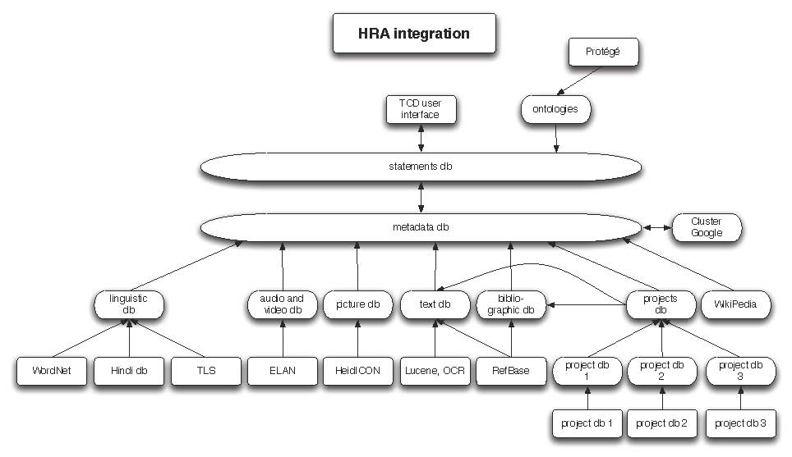
HRA the overall Architecture first shot

Slide 34
Graphical User Interface (GUI)
Lucene
Refbase
HRA Integration
Ontology
Translingual
Concepts
Dabatase (TCD)
Pdf
MySQL
SQL
Database
SOAP
WSDL
WSDL
HeidIcon
EasyDB
HyperImage
WSDL
URZ
(TIFF)
HSM

Slide 35
HRA follows the service oriented approach
HSE Image Search
GeoTWAIN
Ontology
WS-Client
WS-Client
WS-server
Dictionary
WS-server
Location normalizer
WS-server
Web resources
Lucene Indices
DBs

Slide 36
What is a Service
Nowadays every IT resource can be implemented as a service
Grid Computing, Clouds
Service Oriented Architecture is the new paradigm
There are Standards that make Services talk to each other
General standards like SOAP/WSDL or REST
Application domain specific standards specify the XML-Data sent via such an infrastructure

Slide 37
HRA -Web Services Architecture
HRA provides a set of web services to be used by service consumers in the Universität Heidelberg
One of the main services is the search service in the Thesaurus of Geographic Names (TGN) example search ui
The Web Services are REST protocol based and can be easily extended to meet the consumer needs.

Slide 38
More services
A more complex service will have a whole text as input and will give back a list of all locations occurring in the text
An application can then use the visualisation engine to display a map of all these places
Services technology is also used to synchronize Data
Some of the Services are based on eXist XML database

Slide 39
HRA Web Services Architecture
Exist Services Provider
Service Consumers
REST Web Services
Client Applications
Exist DB
Web Browsers
Libraries
Libraries
Exist itself as client

Slide 40
What about LitLink
There is an interest to integrate the work of „cluster near“ activities such as SFB Ritual Dynamics and the Transcultural Studies Project
If LitLink is used to collect data relevant to the cluster‘s agenda we should think of integrating it
How could a bridge between LitLink (Filemaker) and HRA look like?

Slide 41
Graphical User Interface (GUI)
Lucene
Refbase
HRA Integration
Ontology
Translingual
Concepts
Dabatase (TCD)
Pdf
MySQL
SQL
Database
SOAP
WSDL
LitLink Server
FileMaker
LitLink
Client
LitLink
Client
FileMaker
FileMaker

Slide 42
Our Experiments with FileMaker
It is easy to input data but not so easy to export them
But there are methods:
ODBC/JDBC only with Filemaker Server Advanced
HTTP/XML-Export
We used the Python Library pyFileMaker for accessing the later interface
It actually works ☺

Slide 43
Summary HRA as it is now
Repository of information objects of very different kinds distributed in several databases
Integration only on the level of metadata
Including a full text index
Data flow partly via Web services
Separation between Front and Back End
Semantic aware tools on top
New applications are needed (e.g. Geo-referenced data)

Slide 44
Is there a good platform to migrate to?
While looking around for platforms, we found Fedora Commons
In Germany eSciDoc is then a very good choice:
Enhanced infrastructure features, in terms of AAI, search, statistics, etc.
All three existing solutions could be interesting within the cluster (Pubman, VIRR, Faces)
A good platform for new solutions relevant to the cluster (e.g. for geo-referenced data or for collaboration tools)

Slide 45
Why not cooperate?
Got into contact with FIZ and MPDL for possible cooperation
Also contacted Hochschule Bonn-Rhein-Sieg, where WikiDora (JSPWiki + Fedora) had been developed
Wrote a proposal within the 2nd DFG Call on Virtual Research Environments (2 years project)
Bringing together Cluster and Transcultural Studies researcher and eSciDoc developers

Slide 46
VFTS
Virtuelle Forschungsumgebung für Transkulturelle Studien
Integration of Parts of HRA into the eSciDoc Framework
Integration of WikiDora into eSciDoc
Development of eSciDoc infrastructure services for geo-referenced data
Development of a eSciDoc solution for historical geo-referenced data
Development of a Cluster project specific Web Service for analyzing geo-referenced data
Demonstrators in 5 research scenarios

Slide 47
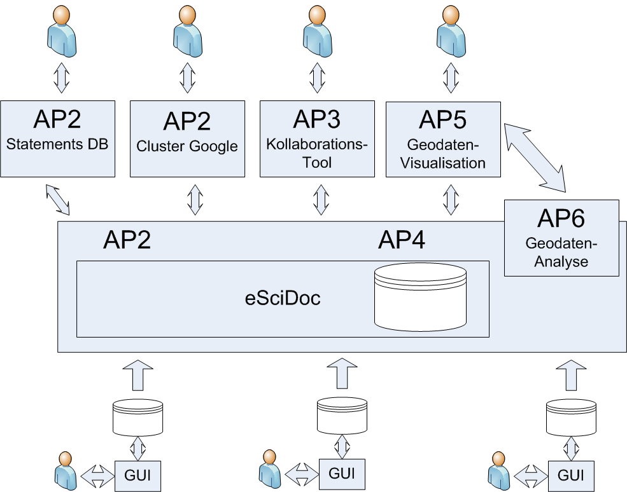
VFTS

Slide 48
Thank you! Questions? More info at:
http://www.asia-europe.uni-heidelberg.de/research/heidelberg-research-architecture
gietz@asia-europe.uni-heidelberg.de

