Slide 1
Ruprecht-Karls-Universität Heidelberg Curt-Engelhorn Chair in American History Prof. Dr. Manfred Berg Summer Semester 2013
The African-American Freedom
Struggle from the Civil War to the
Twenty-First Century
Notes:
1
6/7/2013
1

Slide 2
The Apex of Civil Rights Reform
The Civil Rights Acts of 1957 and 1960
The Kennedy Administration and Civil Rights
Toward the 1964 Civil Rights Act
Toward the Voting Rights Act

Slide 3
Civil Rights Act of 1957
Establishes Civil Rights Commission
Establishes Civil Rights Division in the Department of Justice
Authorizes Department of Justice to sue state official for violating civil rights and voting rights

Slide 4
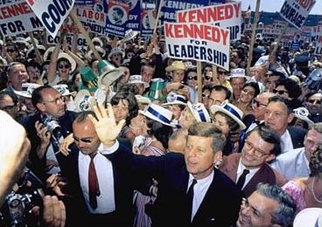
John F. Kennedy, 1917-1963

Slide 5
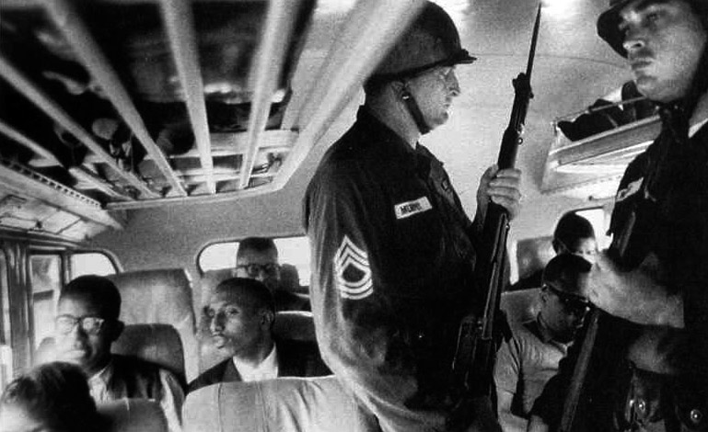
Freedom Rides, 1961

Slide 6
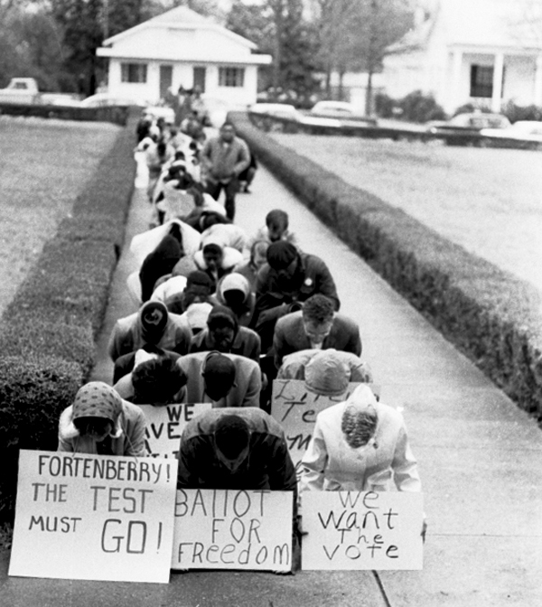
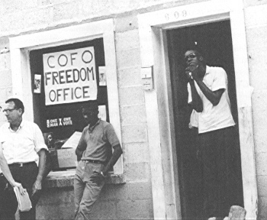
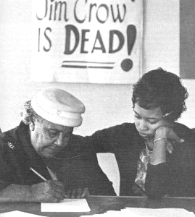
Voter Education Project, 1962-1964

Slide 7
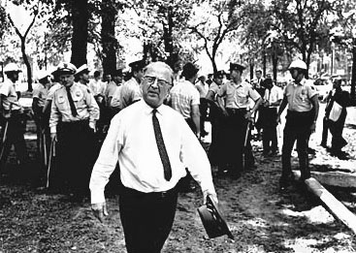
Eugene T. „Bull“ Connor, 1897-1973

Slide 8
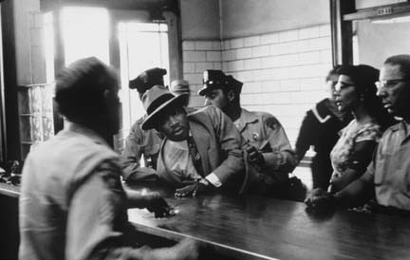
Letter from a Birmingham Jail

Slide 9
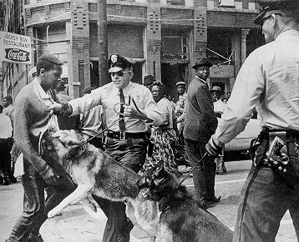
Birmingham, April/May 1963

Slide 10
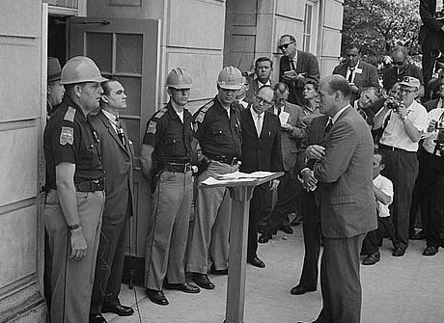
George C. Wallace, 1919-1998

Slide 11
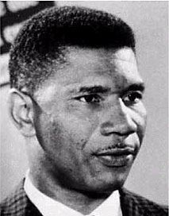
Medgar Evers, 1925-1963

Slide 12
March on Washington, 28.08.1963

Slide 13
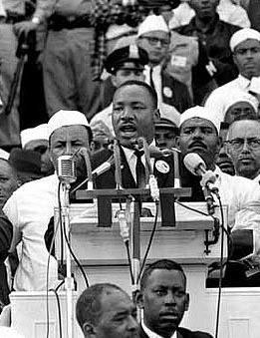
I Have A Dream

Slide 14
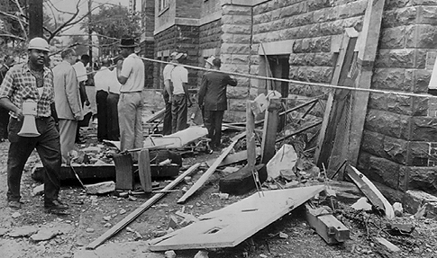
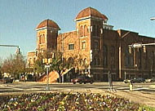
Birmingham, 15.9.1963

Slide 15
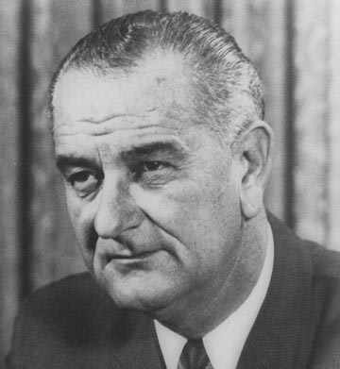
Lyndon B. Johnson, 1908-1973

Slide 16
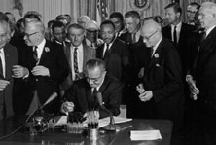
Civil Rights Act 1964
Prohibits Racial Segregation in public facilities
Prohibits racial discrimination on account of skin color, race, national origin, religion, and sex.

Slide 17
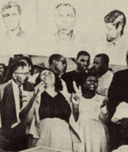
Mississippi Freedom Democratic Party at Atlantic City, 1964
"We didn't come all this way for no two seats when all of us is tired".
Fannie Lou Hamer

Slide 18
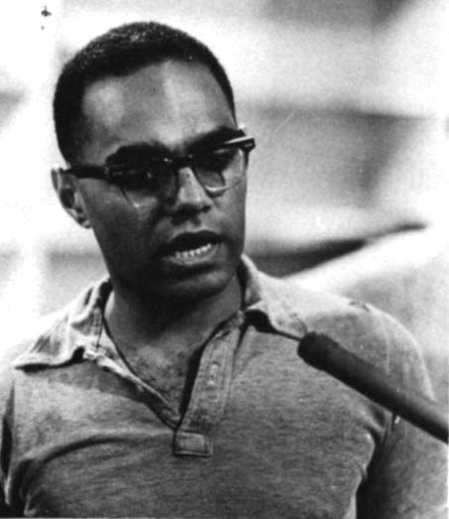
Robert Moses, *1935

Slide 19
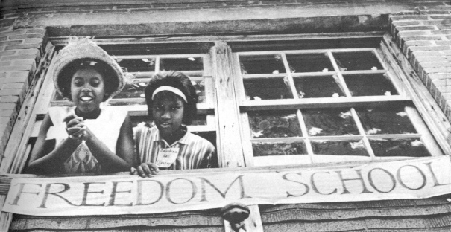
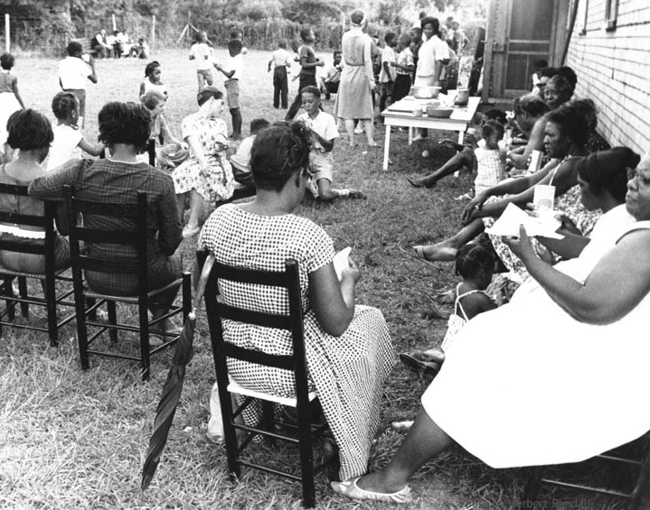
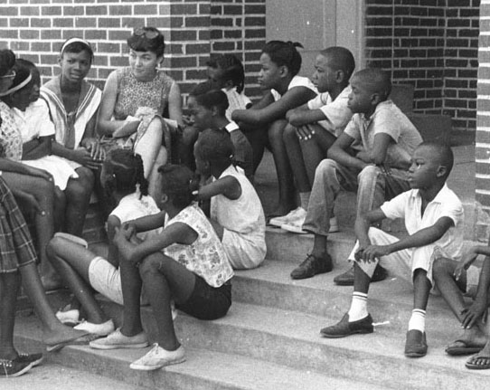
Freedom Summer 1964

Slide 20
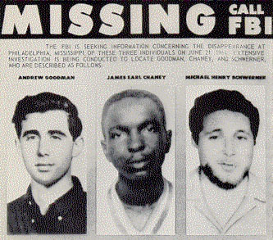
Mississippi is for Murder
Andrew Goodman, 1943-1964
James Chaney, 1943-1964
Michael Schwerner, 1939-1964

Slide 21
Selma, Alabama, 1965

Slide 22
The Voting Rights Act of 1965
Covers all states that require literacy tests and have a fewer than 50% of all eligible adults registered or votíng
Suspends all literacy tests for 5 years
Federal registrars take over registration in parts of the South
States covered by the law have to submit all voting law changes to the Department of Justice for „preclearance“

Slide 23
The Impact of the the Voting Rights Act
1964 1966
Alabama 110,000 250,000
Louisiana 243,000 350,000
Mississippi 29,000 175,000

Slide 24
Civil Rights Reforms of 1964/65
Formal and legal equality?
Major breakthrough; achievement of goals for which blacks had fought and died for decades
Additional laws and court rulings dismantled instituional racism
Part of a larger reform agenda that also included economic opportunity and expansion of the welfare state, e.g. War on Poverty
But: High expectations remain unfulfilled. Black radicalization – White backlash.

